Slide 1
jQuery

Slide 2
What is jQuery?
Query is a lightweight, "write less, do more", JavaScript library.
The purpose of jQuery is to make it much easier to use JavaScript on your website.
jQuery takes a lot of common tasks that require many lines of JavaScript code to accomplish, and wraps them into methods that you can call with a single line of code.

Slide 3
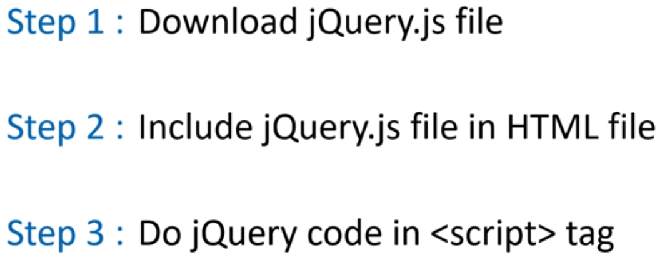
3 Steps jQuery Implementation

Slide 4
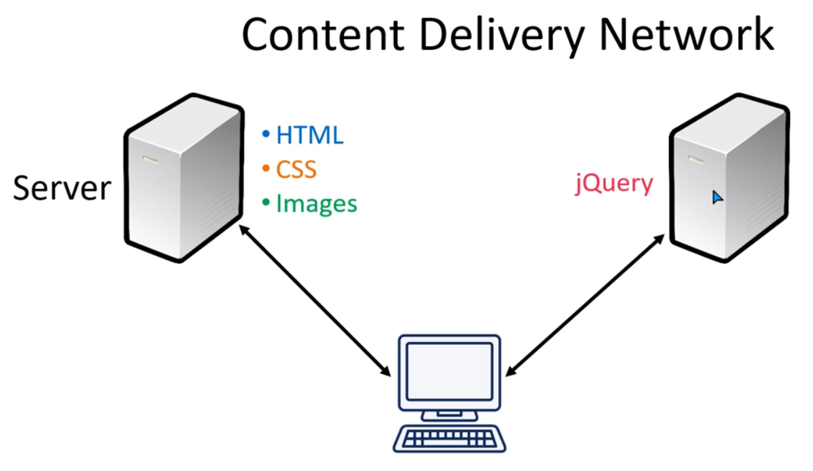
jQuery CDN Path

Slide 5
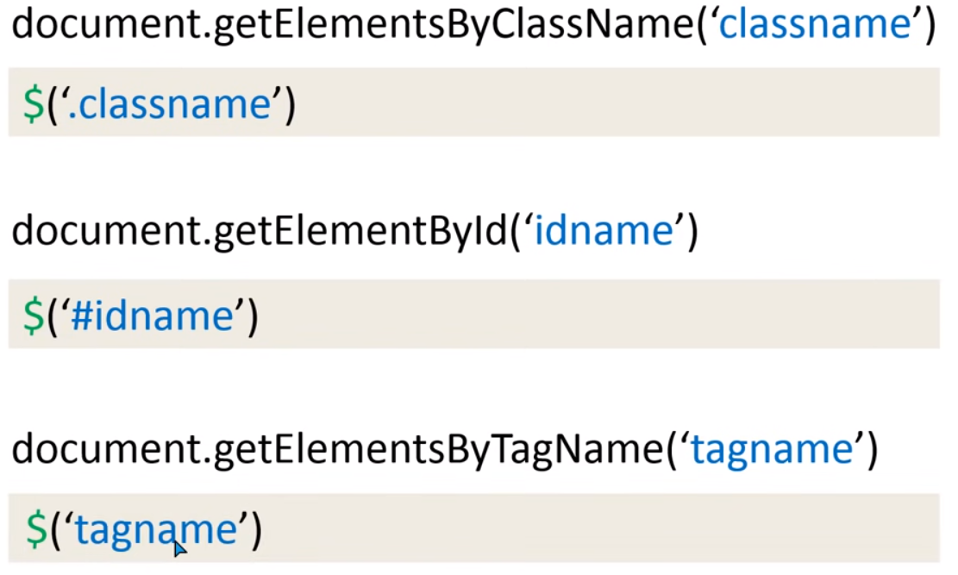
Short Selector Example

Slide 6
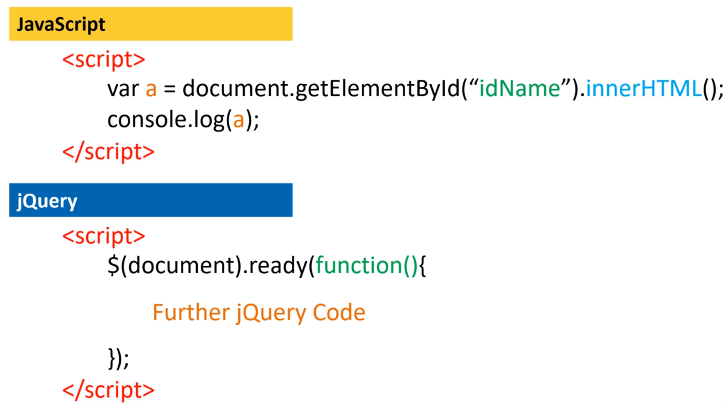
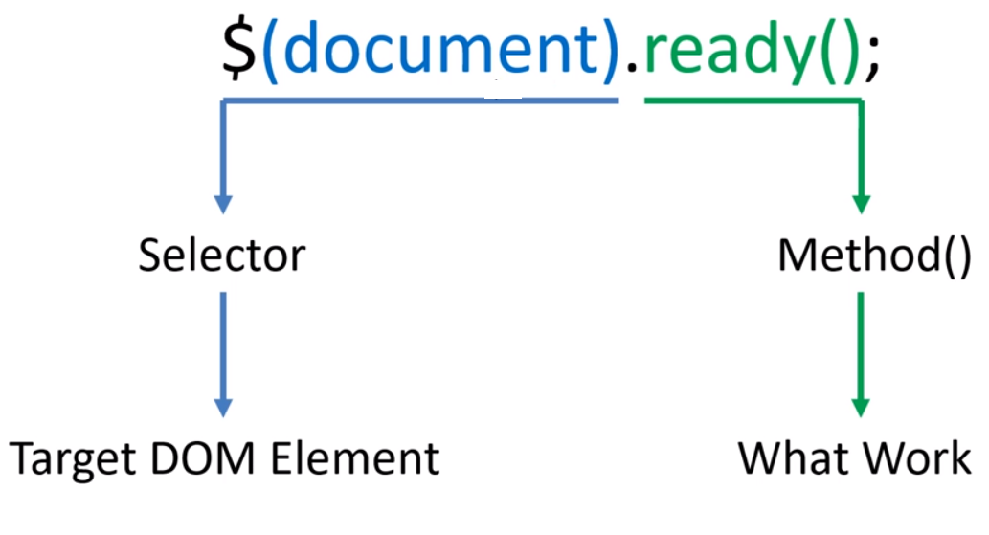
jQuery Basic Syntax

Slide 7
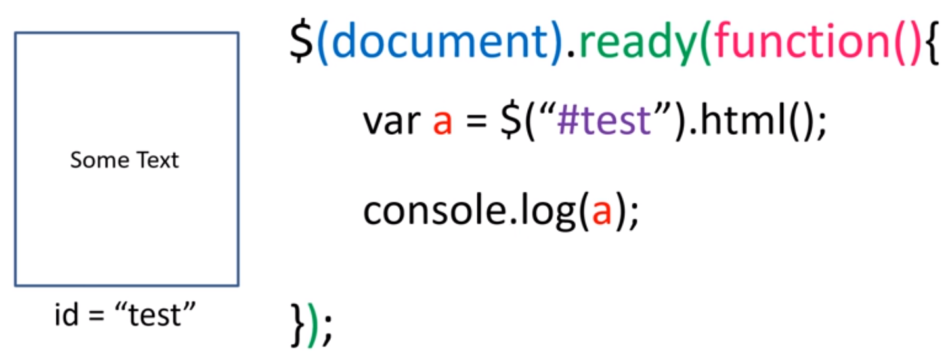
jQuery Basic Syntax

Slide 8
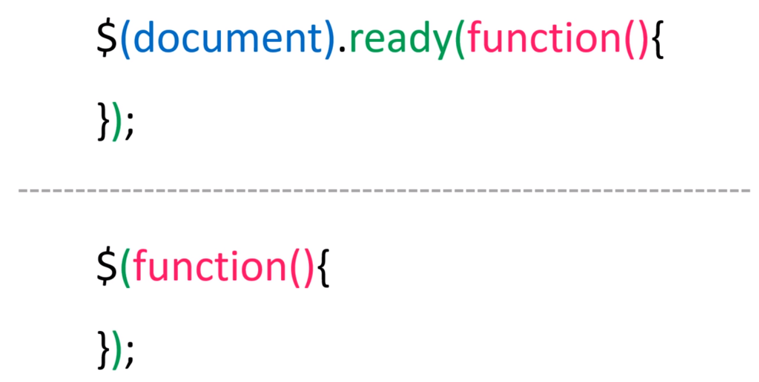
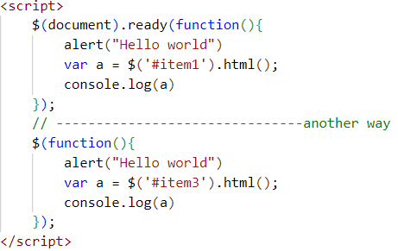
Another method to start jQuery code

Slide 9
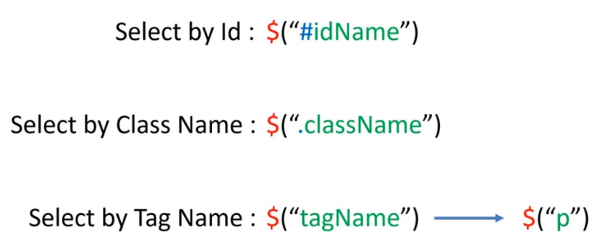
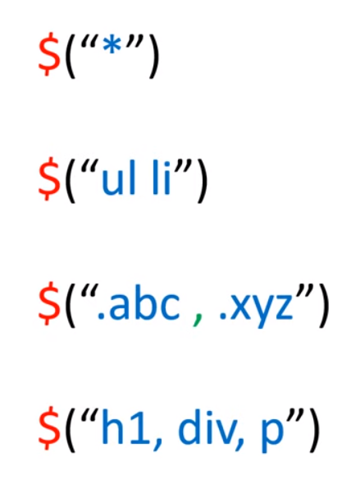
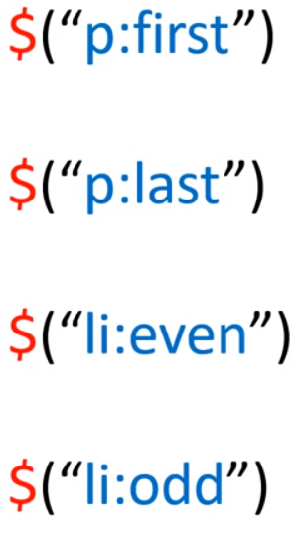
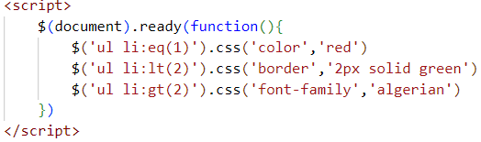
jQuery Selectors
:eq() selector selects an element with a specific index number

Slide 10
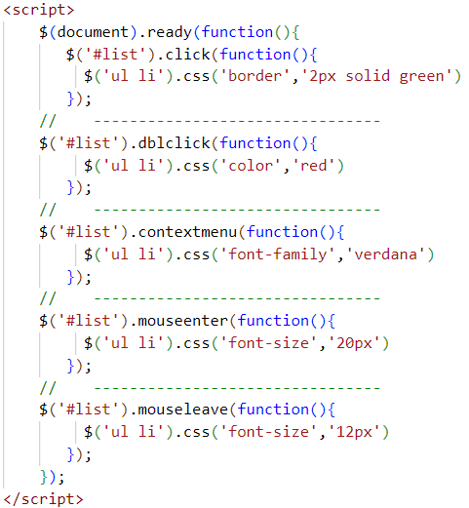
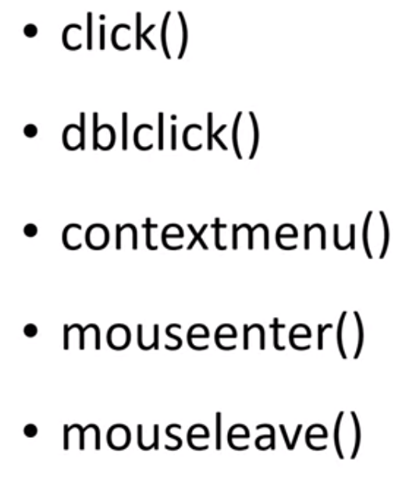
Mouse Event

Slide 11
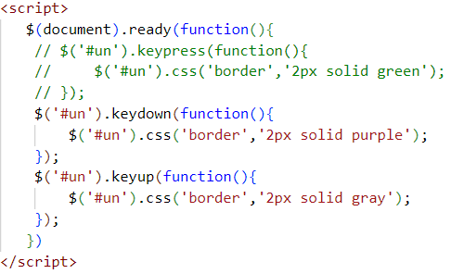
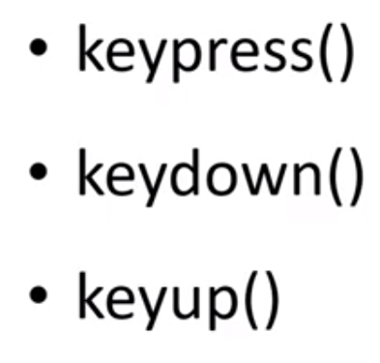
Keyboard event

Slide 12
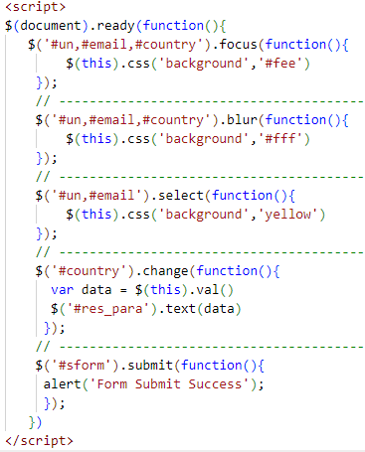
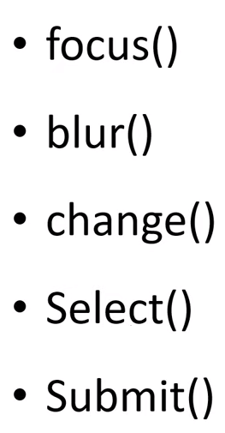
Form Events

Slide 13
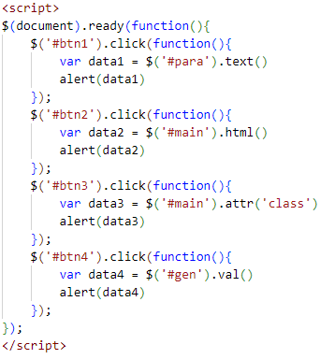
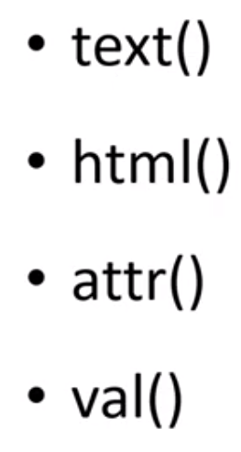
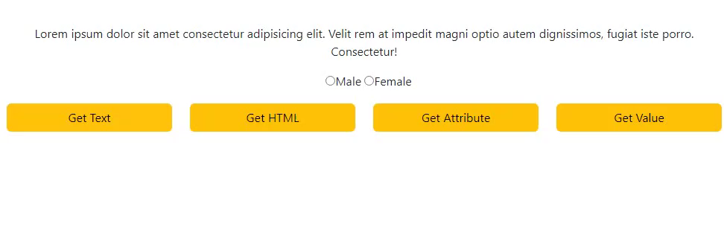
Get Method

Slide 14
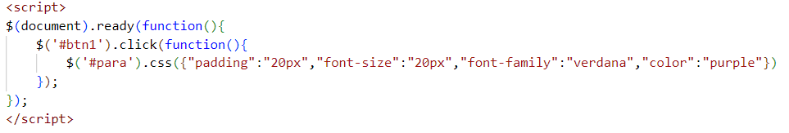

CSS Method

Slide 15

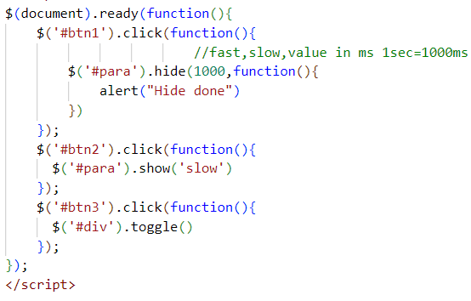


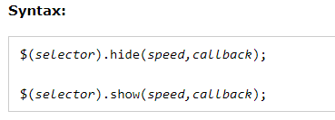
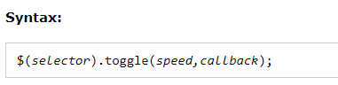
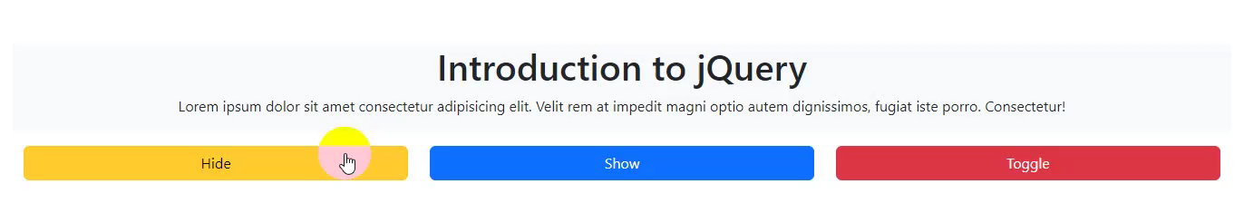
jQuery Hide Show & Toggle Method

Slide 16
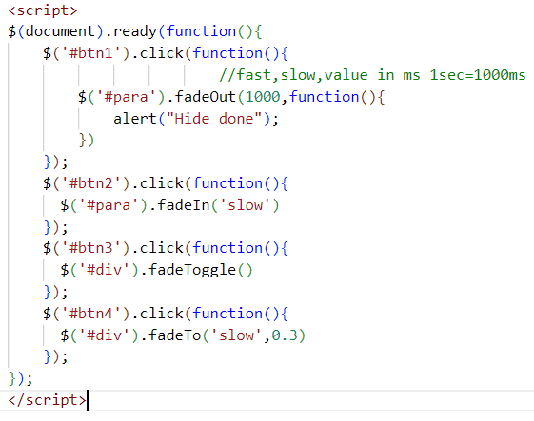
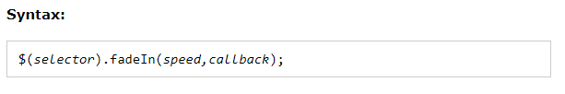
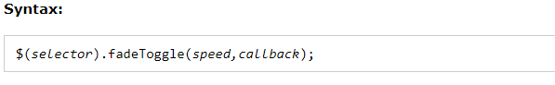
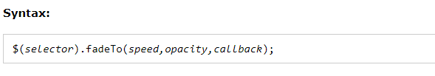
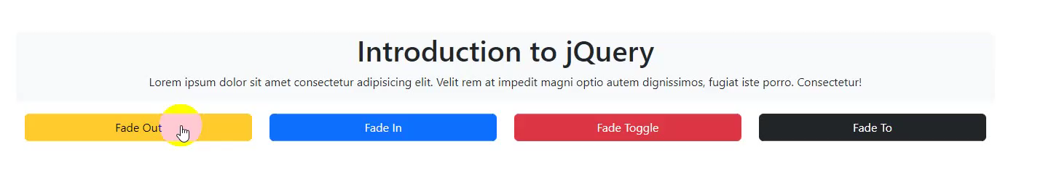
jQuery Effects - Fading
fadeIn()
fadeOut()
fadeToggle()
fadeTo()

Slide 17
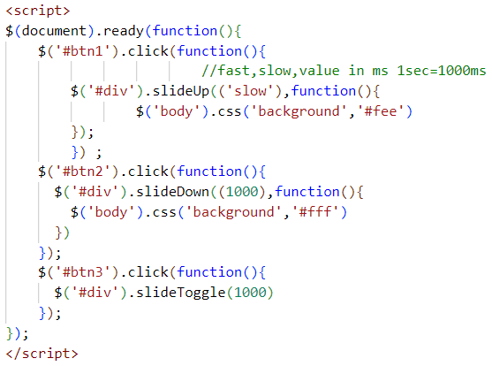
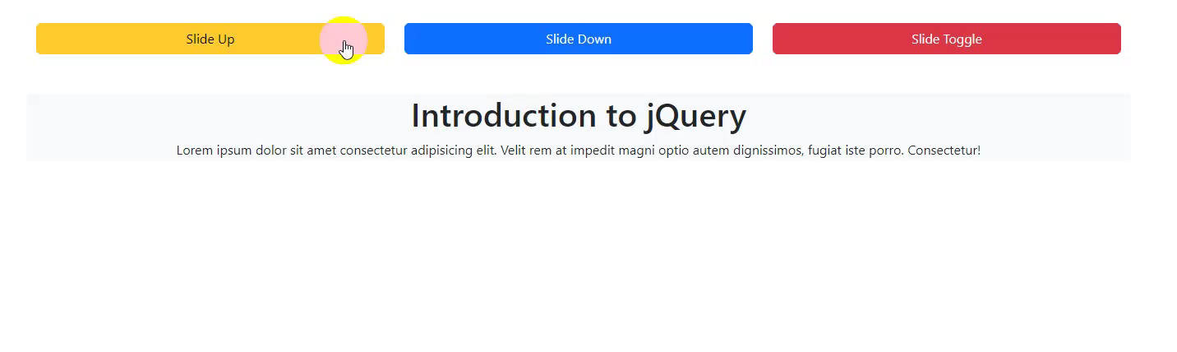
jQuery slideUp , slideDown & SlideToggle

Slide 18
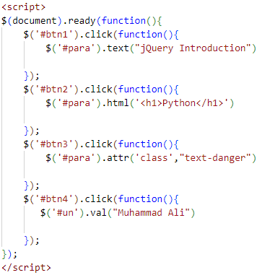
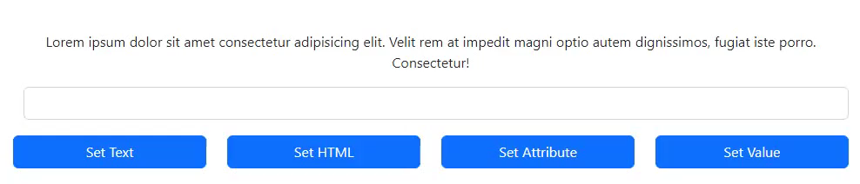
Set method

Slide 19
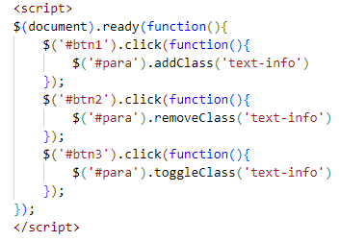
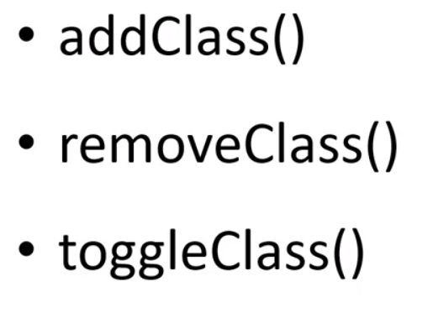
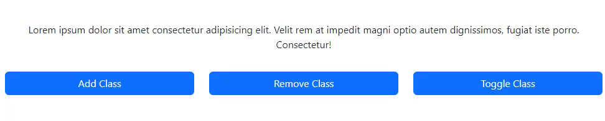
CSs class Method

Slide 20
Plugin
https://www.bestjquery.com/

Slide 21
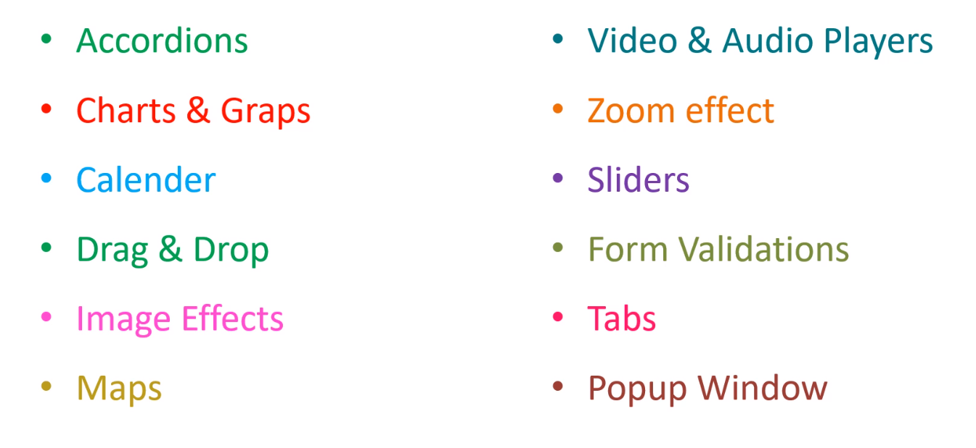
Categories of jQuery plugins

Slide 22
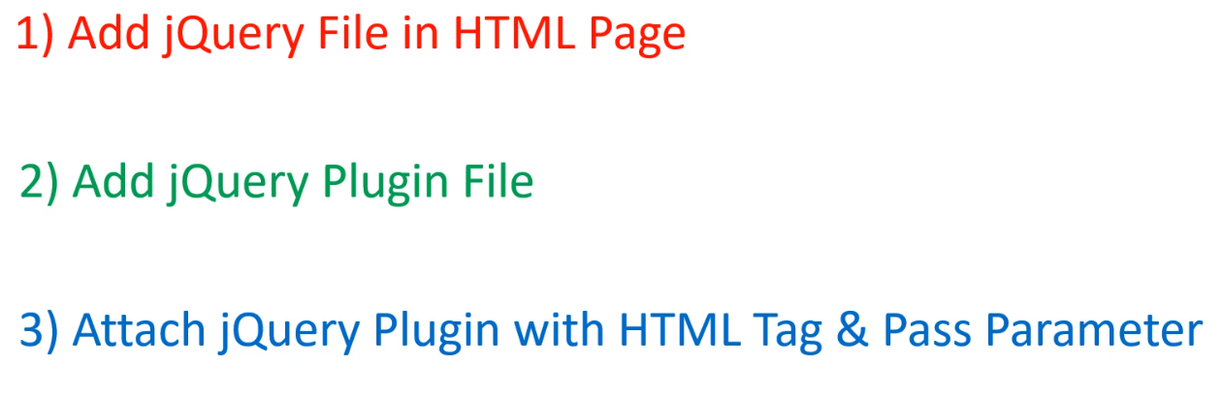
Implement jQuery plugin

Slide 23
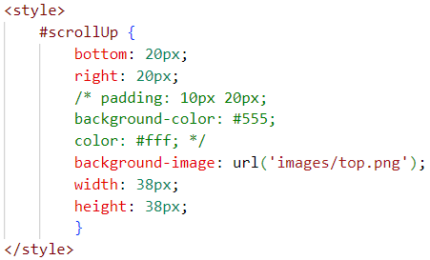
scroll up
https://github.com/markgoodyear/scrollup

Slide 24
Isotope Filter Plugin
https://isotope.metafizzy.co/
Isotope can hide and show item elements with the filter option. Items that match that filter will be shown. Items that do not match will be hidden.
$('.product-item').isotope({
// options
itemSelector: '.item',
layoutMode: 'fitRows'
});
$('.product-menu ul li').click(function(){
$('.product-menu ul li').removeClass('btn btn-warning');
$(this).addClass('btn btn-warning');
var selector = $(this).attr('data-filter');
$(".product-item").isotope({
filter:selector
});
return false });

Slide 25
Google Map
https://www.google.com/maps

